Slide 1

Nextion LCD HMI 모델
Enhanced Series 3.5” : https://nextion.tech/datasheets/nx4832k035/
Basic Series 3.5” :
Address: 8F, Building No.9, Banri wowi, Tongsha Road No.32 , Nanshan Dist., Shenzhen, GD, China
Postal Code: 518000 China
Telephone: +86-755-27955416

Slide 2
NEXTION ENHANCED HMI DISPLAY
MODEL NAME | NX3224K024 | NX3224K028 | NX4024K032 | NX4832K035 | NX4827K043 | NX8048K050 | NX8048K070 | NX8048K070-011R/011C
Size | 2.4″ | 2.8″ | 3.2″ | 3.5″ | 4.3″ | 5.0″ | 7.0″ | 7.0″
Resolution | 320*240 | 320*240 | 400*240 | 480*320 | 480*272 | 800*480 | 800*480 | 800*480
Touch Panel | RTP | RTP | RTP | RTP | RTP | RTP | RTP | RTP/CTP
Color | 65536 | 65536 | 65536 | 65536 | 65536 | 65536 | 65536 | 65536
Flash | 16 MB | 16 MB | 16 MB | 32 MB | 32 MB | 32 MB | 32 MB | 32 MB
RAM | 3584 Byte | 3584 Byte | 3584 Byte | 8192 Byte | 8192 Byte | 8192 Byte | 8192 Byte | 8192 Byte
MCU | 48 MHz | 48 MHz | 48 MHz | 108 MHz | 108 MHz | 108 MHz | 108 MHz | 108 MHz
EEPROM | 1024 Byte | 1024 Byte | 1024 Byte | 1024 Byte | 1024 Byte | 1024 Byte | 1024 Byte | 1024 Byte
GPIOs | 8 | 8 | 8 | 8 | 8 | 8 | 8 | 8
RTC | Yes | Yes | Yes | Yes | Yes | Yes | Yes | Yes
Enclosure | No | No | No | No | No | No | No | Yes
SKU | IM160511002 | IM160511003 | IM160511004 | IM160511005 | IM160511006 | IM160511007 | IM160511008 | IM170428001/IM170421001
Datasheet | Click | Click | Click | Click | Click | Click | Click | Click
Price | $20.4 | $22.4 | $27.4 | $32.4 | $49.9 | $71.9 | $81.9 | $88/108

Slide 3
NEXTION BASIC HMI DISPLAY
MODEL NAME | NX3224T024 | NX3224T028 | NX4024T032 | NX4832T035 | NX4827T043 | NX8048T050 | NX8048T070
Size | 2.4″ | 2.8″ | 3.2″ | 3.5″ | 4.3″ | 5.0″ | 7.0″
Resolution | 320*240 | 320*240 | 400*240 | 480*320 | 480*272 | 800*480 | 800*480
Touch Panel | RTP | RTP | RTP | RTP | RTP | RTP | RTP
Color | 65536 | 65536 | 65536 | 65536 | 65536 | 65536 | 65536
Flash | 4 MB | 4 MB | 4 MB | 16 MB | 16 MB | 16 MB | 16 MB
RAM | 3584 Byte | 3584 Byte | 3584 Byte | 3584 Byte | 3584 Byte | 3584 Byte | 3584 Byte
MCU | 48 MHz | 48 MHz | 48 MHz | 48 MHz | 48 MHz | 48 MHz | 48 MHz
EEPROM | — | — | — | — | — | — | —
GPIOs | — | — | — | — | — | — | —
RTC | — | — | — | — | — | — | —
Enclosure | No | No | No | No | No | No | No
SKU | IM150416002 | IM150416004 | IM150416005 | IM150918001 | IM150416003 | IM150416006 | IM150416007
Datasheet | Click | Click | Click | Click | Click | Click | Click
Price | $16.4 | $18.4 | $22.4 | $27.4 | $44.9 | $64.9 | $74.9

Slide 4
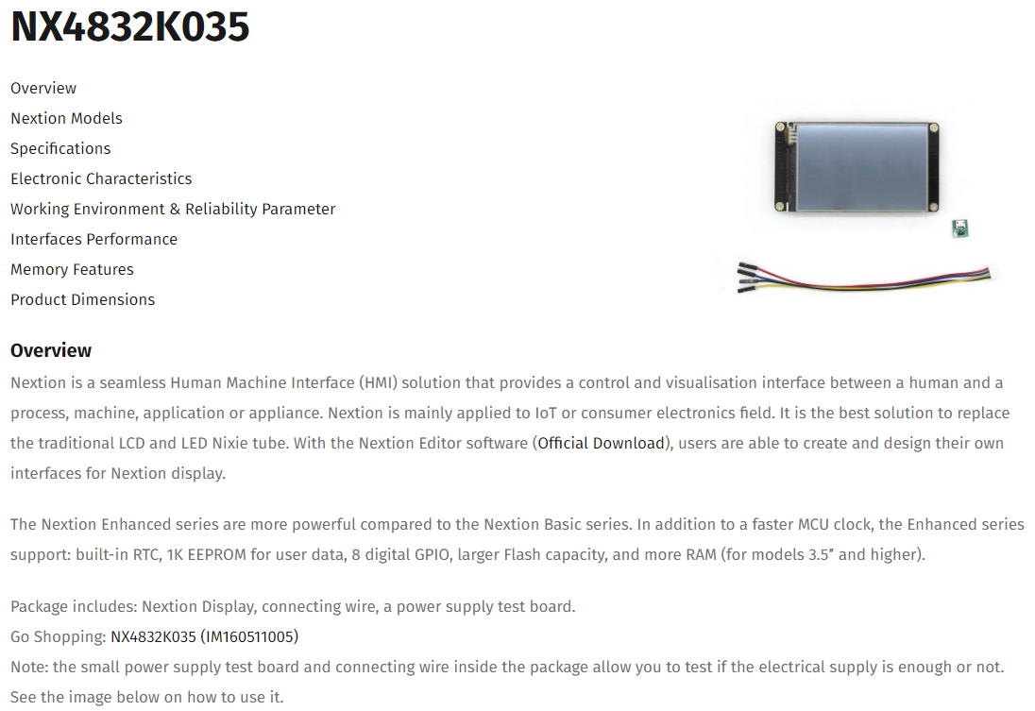

Slide 5
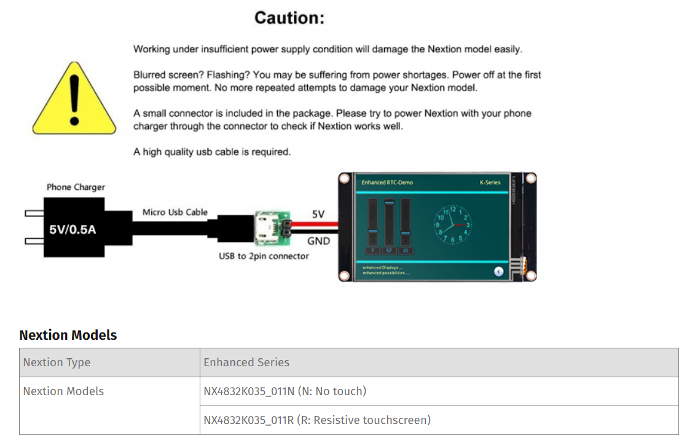

Slide 6
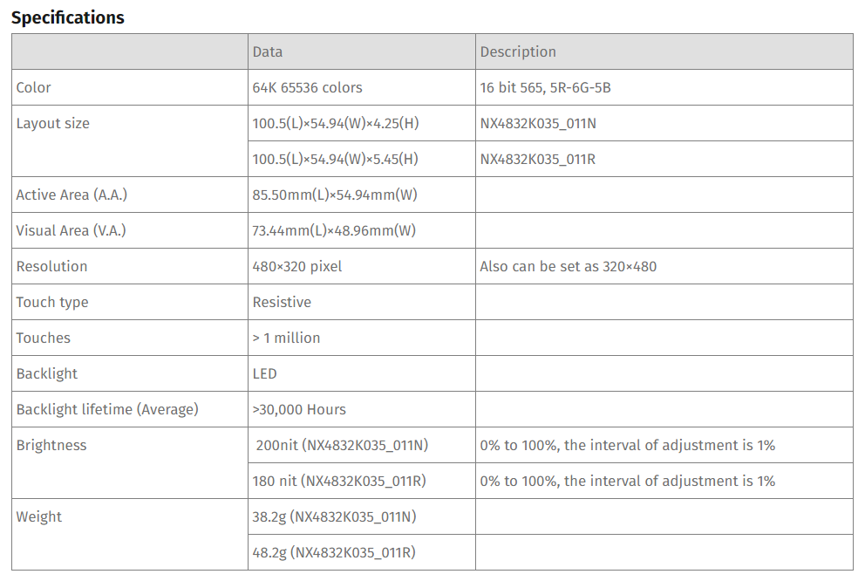

Slide 7
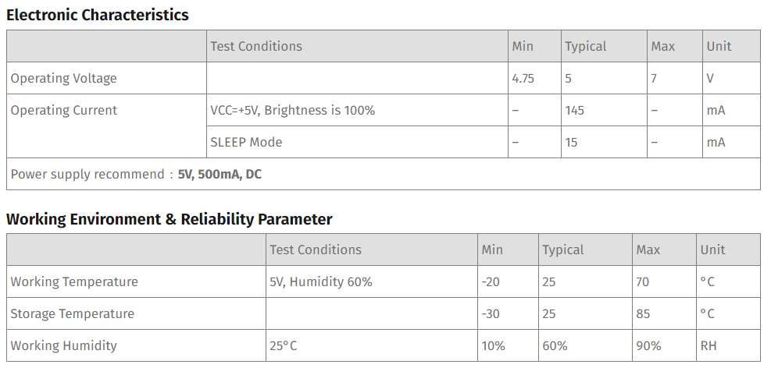

Slide 8
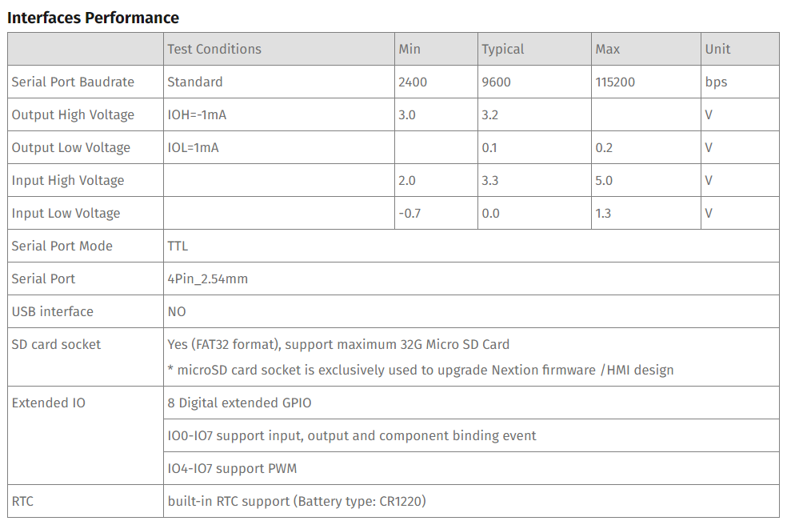

Slide 9
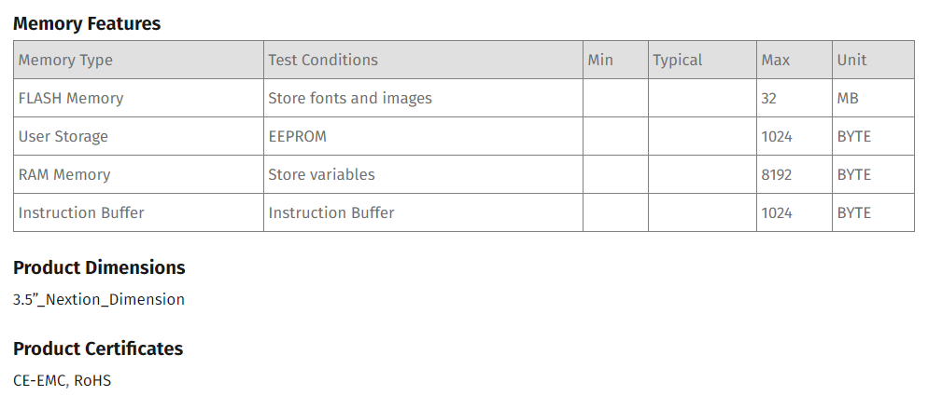

Slide 10
Nextion’s microSD slot is primarily used to upload a TFT project file. – The Intelligent Series has added capabilities, see Forum Announcements
Not all microSD cards are made for use with embedded devices. – especially newer microSD cards made for cameras, etc. Class 10 HC 8GB to 32GB cards have had good success. Others too.
Ensure – microSD card formatted as FAT32 under Windows – microSD card is less than 32 GB – only 1 TFT project file exists on the microSD card – Nextion device is powered off before inserting microSD card – insert the microSD card containing TFT project file – power on Nextion with recommended clean power as per Datasheets – Nextion device is undisturbed while uploading – after upload “successed” indication power off Nextion – after Nextion device is powered off then remove microSD card – power on Nextion with recommended clean power as per Datasheets – if new version of Nextion Editor, allow time for firmware to update – wait for uploaded project to begin running on Nextion device
If microSD upload is unsuccessful – Reformat the microSD card
– ensuring FAT32 under Windows, and try. – use a different microSD card (HC, Class 10, under 32GB), and try. – compile a blank HMI project and try again. – microSD card is not the only method to upload project – try via USB to TTL.
Using the above steps, the Nextion device will always run firmware upload when an inserted microSD is detected at power on (power off before insert/remove)

Slide 11
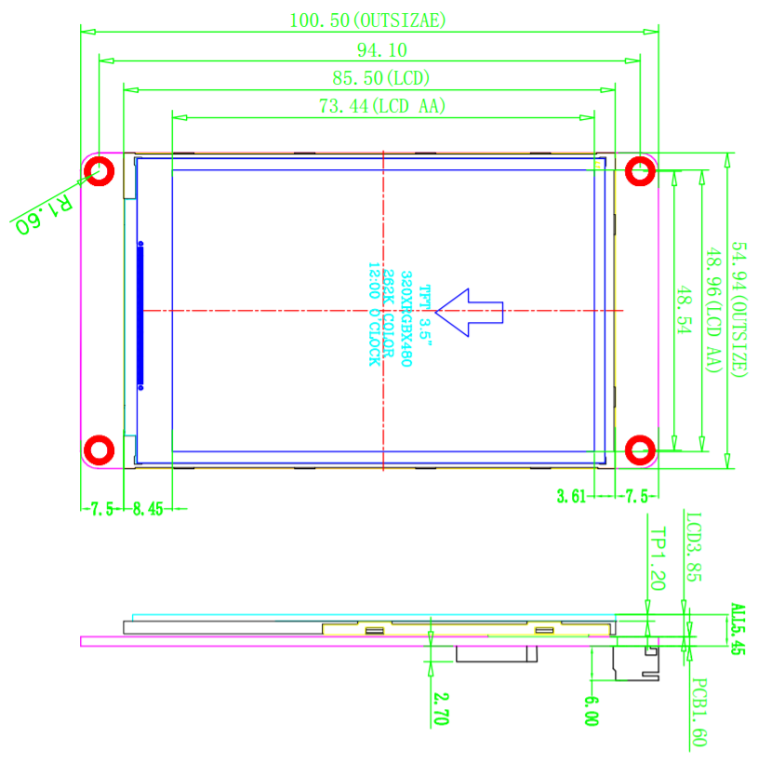
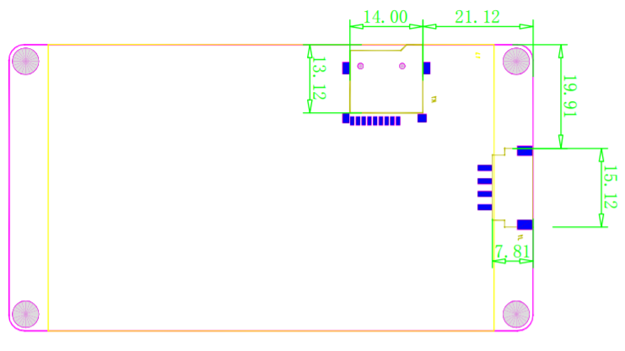

Slide 12
Epsilon-1000

Slide 13
Nextion HMI Serial Communication
Nextion HMI 첫 페이지에서 Serial Baud Rate 설정 : baud=38400
Set passive active Protocol Reparse mode. : recmod=0
Empty 명령 보내기 : ÿÿÿ
After everything is working you can compile the project and export the TFT file to the micro SD card.

Slide 14
https://nextion.ca/portfolio-items/nextion-iteadlib-and-stm32-step-by-step/
This basic project will meet the following requirements – MCU to change pages in response to Button release – MCU to toggle LED on D13 (PA5) on Button press/release – MCU to update a status text on Nextion – MCU to increment and update a number – Nextion timer to evaluate and update status based on value – Communication set to 115200 baud
– an Iteadmaple v1.0 (STM32 Cortex M3) – a Basic Nextion 3.2″ NX4024T032_011 – included Nextion 4 wire Power/UART cable – 4 straight pins from Male/Male 2.54mm header – Iteadlib Arduino Nextion Library v0.90 – Nextion Editor v0.53 – Arduino IDE v1.8.0 – STM32 Arduino IDE boards package

Slide 15
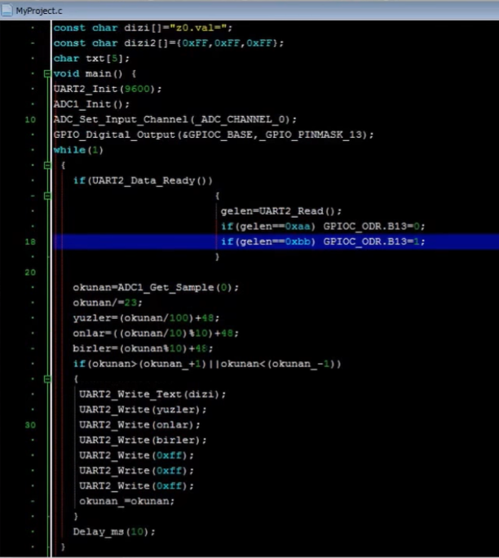
This basic project will meet the following requirements
Serial.print("t4.txt=\"it works!\"");
Serial.write(0xff);
Serial.write(0xff);
Serial.write(0xff);
sprintf(usartTx,"t4.txt=\"it works!\"");
HAL_UART_Transmit_IT(&huart1, (uint8_t*)usartTx, strlen(usartTx));
uint8_t txData = 0xFF;
HAL_UART_Transmit_IT(&huart1,&txData,1);
HAL_UART_Transmit_IT(&huart1,&txData,1);
HAL_UART_Transmit_IT(&huart1,&txData,1);

Slide 16
void loop() {
String message = myNextion.listen(); //check for message
if(message != ""){ // if a message is received...
if( message == "6"){
Serial.println("Booted");
digitalWrite(6,HIGH);
}else if (message == '0xFF'){
Serial.println("Off");
digitalWrite(4,LOW);
// Ride Screen
digitalWrite(5,LOW);
// Options Screen
digitalWrite(6,LOW);
// Self Check Screen
digitalWrite(7,LOW);
// Music Screen
digitalWrite(8,LOW);
// Music Left
digitalWrite(9,LOW);
// Music Play Pause
digitalWrite(10,LOW);
// Music Right
digitalWrite(11,LOW);
}else if (message == "7"){
Serial.println("Riding Screen");
digitalWrite(5,HIGH);
}else if (message == "65 7 6 0 ffff ffff ffff"){
Serial.println("Bump Pressed");
digitalWrite(6,HIGH);
}
else if (message == "8"){
Serial.println("Music Controls");
digitalWrite(8,HIGH);
}else if (message == "65 8 4 0 ffff ffff ffff"){
Serial.println("Left Button");
digitalWrite(9,HIGH);
}else if (message == "65 8 5 0 ffff ffff ffff"){
Serial.println("Play Pause Button");
digitalWrite(10,HIGH);
}else if (message == "65 8 3 0 ffff ffff ffff"){
Serial.println("Right Button");
digitalWrite(11,HIGH);
}else if (message == "3"){
Serial.println("Self Check Page");
digitalWrite(7,HIGH);
}else {
Serial.println("INVALID INPUT");
digitalWrite(4,LOW);
// Ride Screen
digitalWrite(5,LOW);
// Options Screen
digitalWrite(6,LOW);
// Self Check Screen
digitalWrite(7,LOW);
// Music Screen
digitalWrite(8,LOW);
// Music Left
digitalWrite(9,LOW);
// Music Play Pause
digitalWrite(10,LOW);
// Music Right
digitalWrite(11,LOW);
}
Serial.println(message); //...print it out
}

Slide 17
// LCD bağlantıları tanımlanıyor
sbit LCD_RS at GPIOE_ODR.B8; // LCD E portunun 4,5,6,7,8,9,10
sbit LCD_EN at GPIOE_ODR.B10;
sbit LCD_D4 at GPIOE_ODR.B4;
sbit LCD_D5 at GPIOE_ODR.B5;
sbit LCD_D6 at GPIOE_ODR.B6;
sbit LCD_D7 at GPIOE_ODR.B7;
// LCD bağlantıları tanımlandı
/*
bit 1–bit 0 or 1
sbit 1–bit 0 or 1
(unsigned) char 1 0 .. 255
signed char 1 - 128 .. 127
(signed) short (int) 1 - 128 .. 127
unsigned short (int) 1 0 .. 255
(signed) int 2 -32768 .. 32767
unsigned (int) 2 0 .. 65535
(signed) long (int) 4 -2147483648 .. 2147483647
unsigned long (int) 4 0 .. 4294967295
*/
long page,component;
char rx_buffer,rx_array[8]; // change value to adjust for buffer size
int i=0,j=0;
char txt[4];
char dizi[]="a";
////////////////////////////////////////////////////////////
/*
Burada hexadesimal sayının ekranda doğru görülebilmesi için yüksek değerli 4 biti alınıyor. Daha sonra karaktere dönüştürülüyor.
Mesela 0x65 sayısının 6’sı alınıyor
ve daha sonra 48 ile toplanarak ‘6’ karakterine dönüştürülüyor.
Fakat rakam 10 ve 10’dan büyükse yani A,B.C.D.E.F olursa
55 ile toplanarak karaktere dönüştürülüyor.
Karaktere dönüştürülmezse LCD’de farklı görünecektir.
*/
int short ascii2Hex(char ascii){
int short hexValue;
if (ascii>57) {
hexValue = (ascii-55);
}
else {
hexValue = (ascii-48);
}
return hexValue;
}
void hextostr(char eleman)
{
char sol,sag;
sol=(eleman>>4)&0x0F;
if(sol>=10)
{
sol+=55;
}
else
sol+=48;
sag=eleman&0x0F;
if(sag>=10)
{
sag+=55;
}
else
sag+=48;
txt[0]='0';
txt[1]='x';
txt[2]=sol;
txt[3]=sag;
}

Slide 18
////////////////////////////////////////////////////////////
void main()
{
GPIO_Digital_Output(&GPIOE_BASE, _GPIO_PINMASK_9); //R/W pini şaseye çekiliyor.
GPIOE_ODR.B9=0;
// UART ayarlamaları yapılıyor.
UART3_Init_Advanced(115200, _UART_9_BIT_DATA, _UART_EVENPARITY, _UART_ONE_STOPBIT, &_GPIO_MODULE_USART3_PD89);
// UART3_Init(9600);
USART3_CR1bits.RXNEIE = 1; // enable uart rx interrupt
NVIC_IntEnable(IVT_INT_USART3); // enable interrupt vector
EnableInterrupts(); // enable core interrupts
Lcd_Init(); //LCD kullanıma hazır hale getiriliyor.
Lcd_Cmd(_LCD_CLEAR); //LCD ekran temizleniyor.
while(1)// Endless loop
{ //'t0.txt="Hello!"'
//0x74 0x31 0x2E 0x74 0x78 0x74 0x3D 0x22 0x48 0x65 0x6C 0x6C 0x6F 0x21 0x22 0xFF 0xFF 0xFF
// SAYFA NUMARASI GELECEK
if(i==6)
{
USART3_CR1bits.RXNEIE = 0;
hextostr(rx_array[2]);
UART3_Write_Text("t0.txt=");
UART3_Write(0x22);// " işareti
UART3_Write_Text(dizi);
UART3_Write(0x22); // " işareti
UART3_Write(0xFF);
UART3_Write(0xFF);
UART3_Write(0xFF);
Delay_ms(30);
lcd_out(1,1,txt);
if(rx_array[2]==0x02)
{
lcd_out(3,1,"tamam");
}
hextostr(rx_array[1]);
lcd_out(2,1,txt);
i=0;
USART3_CR1bits.RXNEIE = 1;
}
}
}
///////////////////////////////////////////////////////////////////////////
void interrupt() iv IVT_INT_USART3 ics ICS_AUTO {
// Gelmesini beklediğim bilgi
//0x65 0x00 0x01 0x00 0xFF 0xFF 0xFF
if(UART3_Data_Ready()&& i<=6) // If data is received
{
rx_array[i]=Uart3_Read();
i++;
}
}
void main()
{
UART2_Init_Advanced(57600, _UART_8_BIT_DATA, _UART_NOPARITY, _UART_ONE_STOPBIT, &_GPIO_MODULE_USART2_PA23);
Delay_ms(200);
UART2_Write_Text("try"); // gelen veriyi tekrar gönder.
while(1) //Sonsuz döngü.
{
if(UART2_Data_Ready()) // Eğer UART3'e veri gelmiş ise
{
UART2_Write_Text("n0.val=55"); // gelen veriyi tekrar gönder.
UART2_Write(0xFF);
UART2_Write(0xFF);
UART2_Write(0xFF);
}
}
}

Slide 19
#define NEX_RET_CMD_FINISHED (0x01)
#define NEX_RET_EVENT_LAUNCHED (0x88)
#define NEX_RET_EVENT_UPGRADED (0x89)
#define NEX_RET_EVENT_TOUCH_HEAD (0x65)
#define NEX_RET_EVENT_POSITION_HEAD (0x67)
#define NEX_RET_EVENT_SLEEP_POSITION_HEAD (0x68)
#define NEX_RET_CURRENT_PAGE_ID_HEAD (0x66)
#define NEX_RET_STRING_HEAD (0x70)
#define NEX_RET_NUMBER_HEAD (0x71)
#define NEX_RET_INVALID_CMD (0x00)
#define NEX_RET_INVALID_COMPONENT_ID (0x02)
#define NEX_RET_INVALID_PAGE_ID (0x03)
#define NEX_RET_INVALID_PICTURE_ID (0x04)
#define NEX_RET_INVALID_FONT_ID (0x05)
#define NEX_RET_INVALID_BAUD (0x11)
#define NEX_RET_INVALID_VARIABLE (0x1A)
#define NEX_RET_INVALID_OPERATION (0x1B)
1
16 #include "NexGauge.h"
17
18 NexGauge::NexGauge(uint8_t pid, uint8_t cid, const char *name)
19 :NexObject(pid, cid, name)
20 {
21 }
22
23 bool NexGauge::getValue(uint32_t *number)
24 {
25 String cmd = String("get ");
26 cmd += getObjName();
27 cmd += ".val";
28 sendCommand(cmd.c_str());
29 return recvRetNumber(number);
30 }
31
32 bool NexGauge::setValue(uint32_t number)
33 {
34 char buf[10] = {0};
35 String cmd;
36
37 utoa(number, buf, 10);
38 cmd += getObjName();
39 cmd += ".val=";
40 cmd += buf;
41
42 sendCommand(cmd.c_str());
43 return recvRetCommandFinished();
44 }
45

Slide 20
Nextion LCD HMI 연동 - 개발 진행 순서
Nextion & target board 연결 : 5V Power, UART → Conduc. Board or AV PCB 3.3 UART for LCD, UART for Debug..

